Slide 1
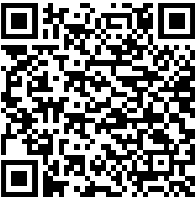
Join Pi Sigma Alpha
1
2
3
Are you a junior with a GPA of 3.615 or senior with a GPA of 3.583 or higher?
Have you completed 10 credits in PSCI courses including at least one 3000 or 4000-level course?
Is your average grade in PSCI courses B or higher?
If you answered “Yes” to all 3 questions, you are eligible to join Pi Sigma Alpha– the national political science honor society. Members receive honor cords at graduation and have access to scholarships, leadership opportunities, and networking opportunities.
Submit your application at
https://politicalscience.unt.edu/forms/spring-2023-pi-sigma-alpha-application
Questions? Contact Catherine Borck at Catherine.Borck@unt.edu.
Application deadline March 10th.

